Slide 1
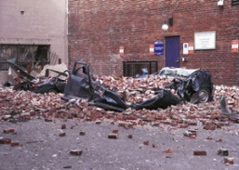
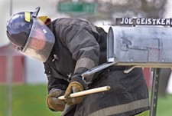

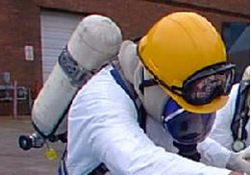
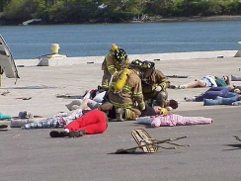

Disaster Site Worker Safety
Health Hazards

Slide 2
Objectives
Identify the Routes of Entry
Provide an overview of health hazards that workers are exposed.
  Chemical (Airborne Contaminants)
  Physical
  Biological
  Ergonomic
Identify health hazards exposing site workers during disaster response.

Slide 3
Routes of Entry
Inhalation
One of the most common ways in which chemicals enter your body.
Dust, mist, fumes and vapors can be inhaled through your nose or mouth and travel into your lungs where they can begin to do damage.
Ingestion
Occurs if you have hazardous materials on your hands while you are eating or smoking.
Possible to swallow chemicals if food is left uncovered where there is a risk of exposure to the chemicals.
Absorption
Some hazardous materials can enter your body through your skin and eyes.
Abrasions and punctures in your skin’s surface will increase the rate at which the chemical is absorbed into your body.
Injection
Chemicals can enter your body and particularly the blood stream, through lacerations, punctures or syringe needles.

Slide 4
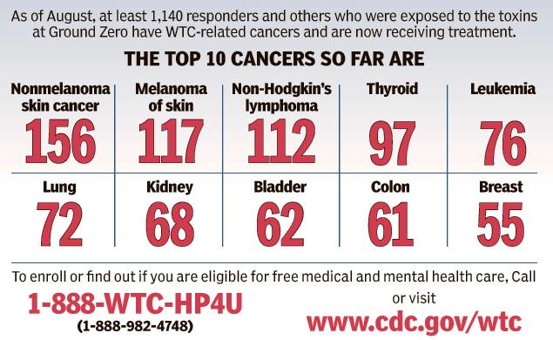
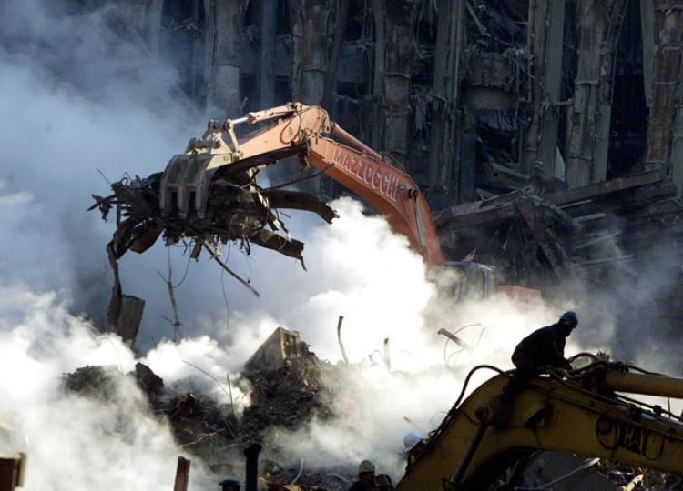
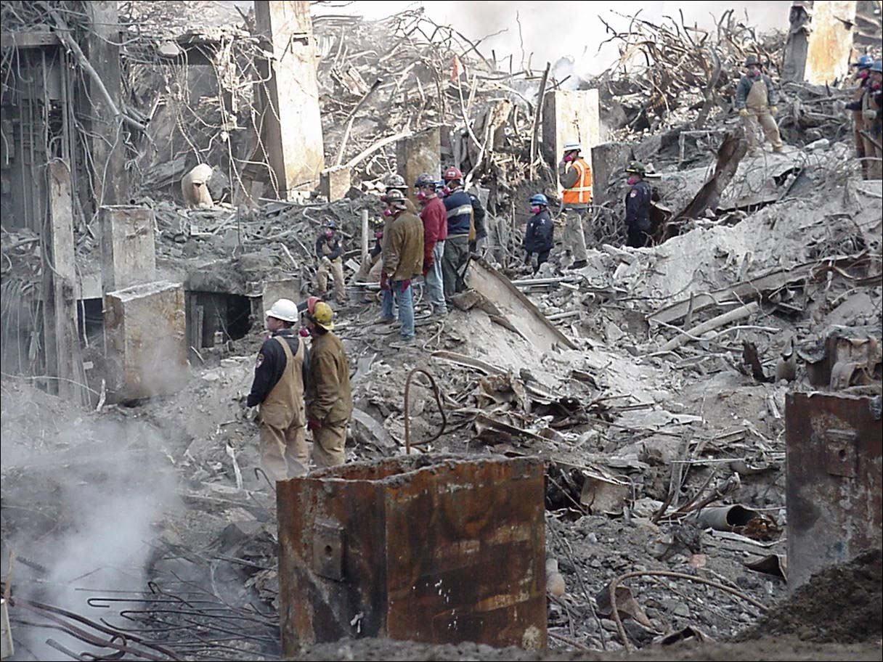
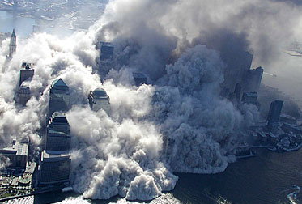

chemical
Airborne Contaminants
Airborne concentrations of mists, vapors, gases, or solids that are in the form of dusts or fumes.
  Lead
  Silica
  Asbestos
  Carbon Monoxide
# 1 Health Hazard for Disaster Site Workers.

Slide 5
Airborne Exposure
LEAD
Significant lead exposures can arise from removing paint from surfaces that were previously coated with lead-based paint, such as in bridge repair, residential renovation, and demolition.
Lead is found in products such as:
Flame-torch cutting, welding, the use of heat guns, sanding, scraping and grinding.
Abrasive blasting of bridges and other structures containing lead-based paints.
Use of torches and heat guns, and sanding, scraping, and grinding lead-based paint surfaces.
Maintaining process equipment or exhaust duct work.

Slide 6
Airborne Exposure
ASBESTOS
Asbestos is dangerous because it has the ability to break down into microscopically thin fibers. These fibers are so small they can remain airborne for days after they were initially disturbed.
Structures built prior to 1980 could likely have asbestos.
Thermal system insulation is of the greatest concern for worker exposure.
Asbestos is found in products such as:
  Sprayed-on fireproofing
  Pipe insulation
  Floor tiles
  Cement pipe and sheet
  Roofing felts and shingles
  Ceiling tiles
  Fire-resistant drywall
  Drywall joint compounds
  Acoustical products

Slide 7


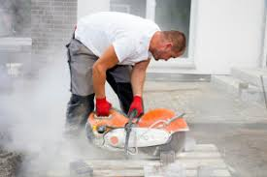
Airborne Exposure
SILICA
Silica hazards are typically found in the sand blasting, concrete cutting, crushing, grading and demolition.
Visible dust is often a good indicator of Silica.
Click for safe operations

Slide 8
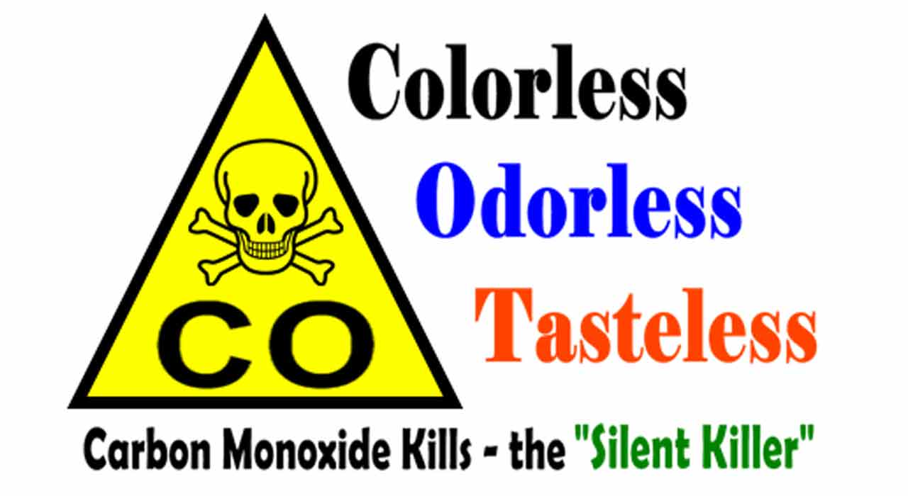
AIRBORNE Exposure
CARBON MONOXIDE (CO)
Not typically a result of the disaster.
Primary Source: Incomplete combustion of organic materials.
Gasoline fueled combustion engine.
Commonly found in generators, light towers, dewatering operations and idle vehicles.

Slide 9
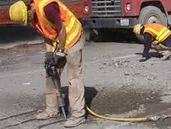
PHYSICAL
Physical
Excessive levels of noise, vibrations and extremes of temperature and fatigue.

Slide 10
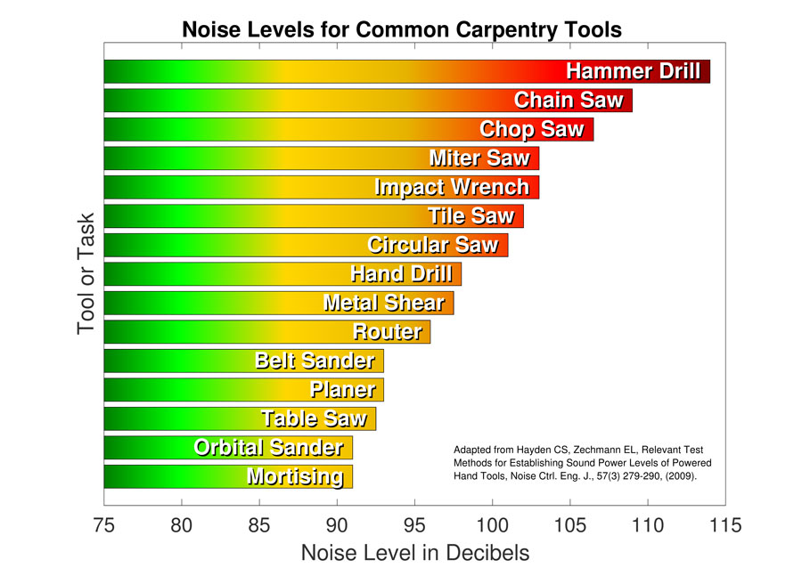
noise
Any high noise level can damage your hearing permanently
High noise sources include:
  Machinery
  Power Tools
  Demolition
  Explosives
OSHA Action level at 85db.

Slide 11
noise
Basic Types of Hearing Protection
Ear Plugs – Inserted into the ear cavity to dampen loud noises
Ear Muffs – Cover the entire ear
Hearing protection devices must provide a complete seal to be effective.
OSHA Pocket Guide 3498 “PROTECTING YOURSELF FROM NOISE IN CONSTRUCTION”

Slide 12
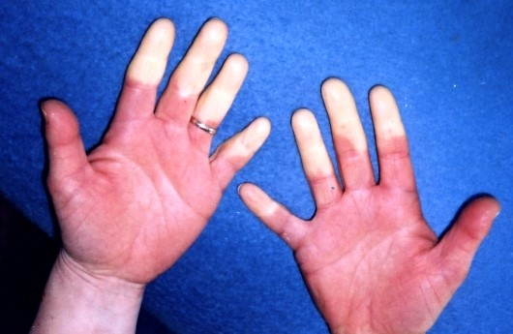
Vibration
Vibration-induced white finger (VWF) is the most common condition among the operators of hand-held vibrating tools.
Vibration can cause changes in tendons, muscles, bones and joints, and can affect the nervous system.

Slide 13
HAVS Symptoms
The following symptoms are known as Hand-Arm Vibration Syndrome (HAVS).
Tingling and loss of sensation in the fingers
Loss of light touch
Pain and cold sensations between periodic white finger attacks
Loss of grip strength
Bone cysts in fingers and wrists

Slide 14
Heat stress
HEAT ILLNESS
HEAT EXHAUSTION
HEAT STROKE
The progression of Heat Stress Emergencies.

Slide 15
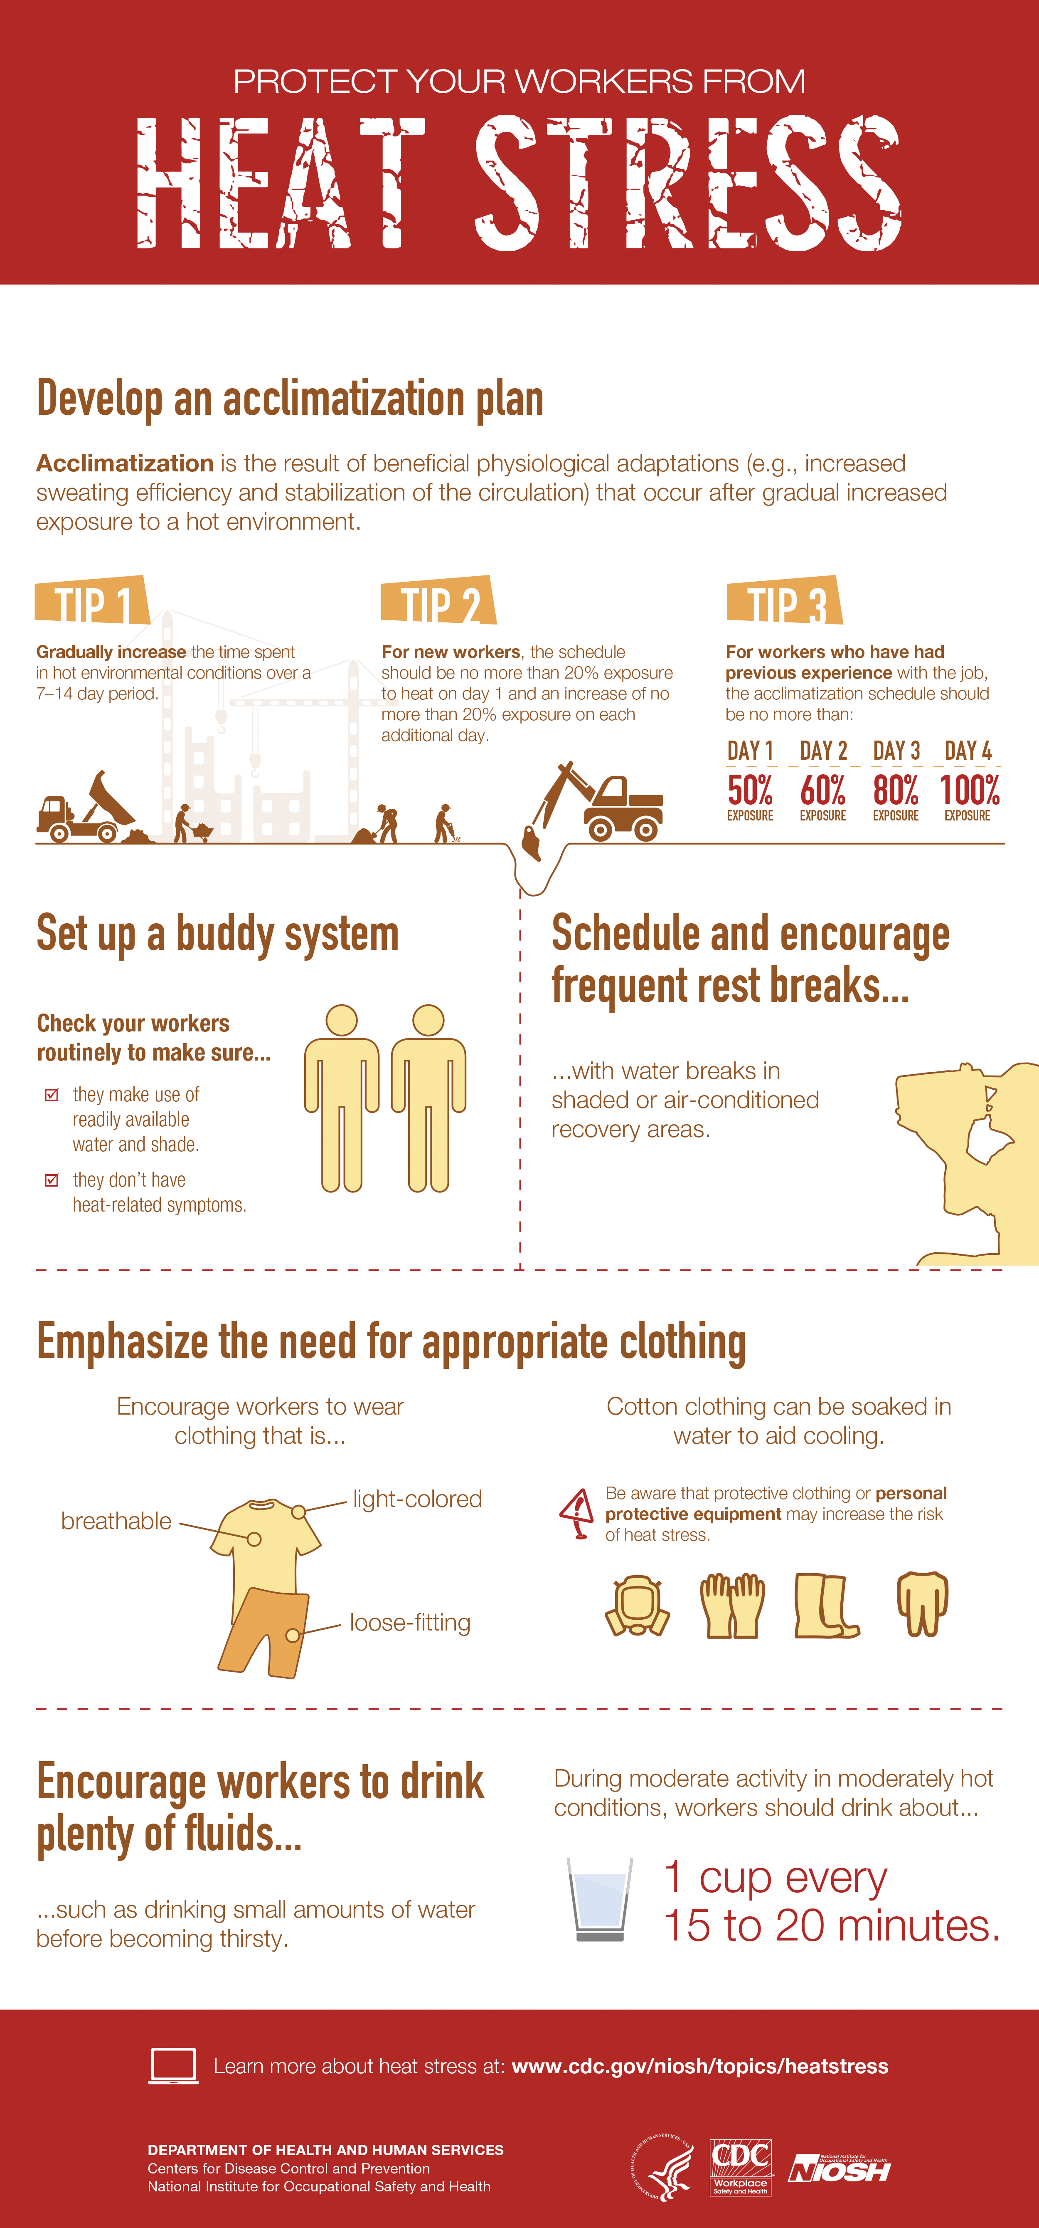


HEAT INDEX
Several resources available to prevent HEAT related emergencies.
OSHA 3154 “PROTECTING WORKERS FROM HEAT STRESS”

Slide 16

Cold Stress
Cold-related illnesses can slowly overcome a person who has been chilled by low temperatures, brisk winds, or wet clothing.
Hypothermia can occur when land temperatures are above freezing or water temperatures are below 98.6ºF/37ºC.
OSHA 3156 “PROTECTING WORKERS FROM COLD STRESS”

Slide 17
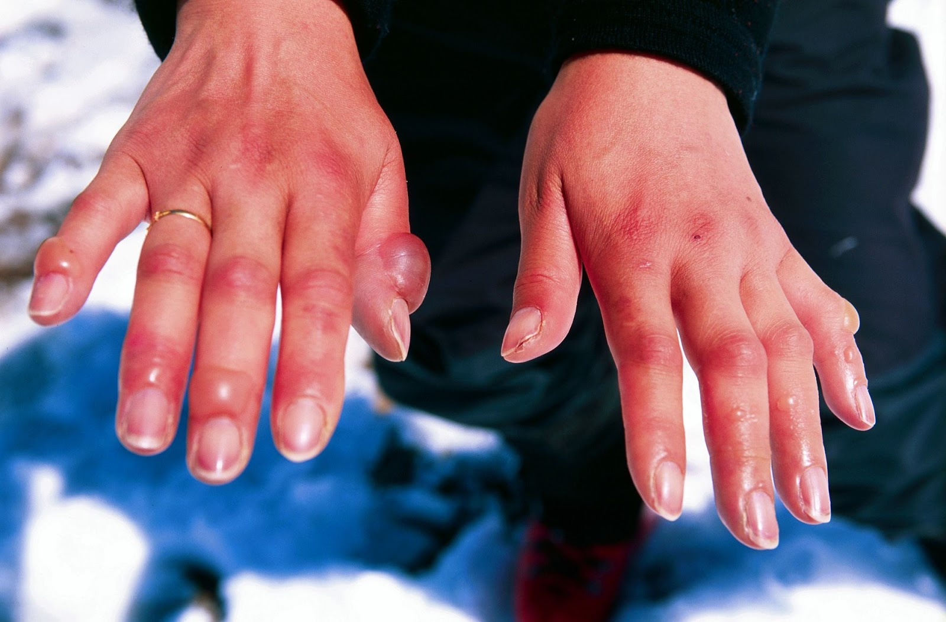

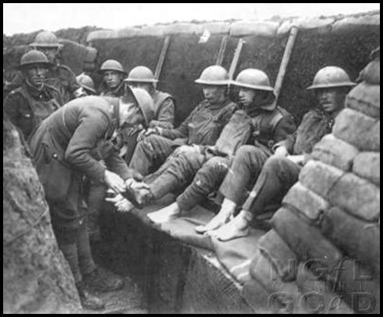
Cold Stress
Cold Stress Emergencies are non-progressive.
Trench Foot
Frostbite
Hypothermia
OSHA 3156 “PROTECTING WORKERS FROM COLD STRESS”

Slide 18
Fatigue
Fatigue is a message to the body to rest
Fatigue become distressing and overwhelming
Some symptoms:
  Weariness
  Irritability
  Reduced alertness, concentration, and memory
  Increased susceptibility to illness
  Headache
  Loss of appetite and digestive problems

Slide 19

Fatigue
Work Hours & Rest Periods
Site Conditions
Living Conditions
Nature of Work
Management & Admin Support
Emotional Stress
Fatigue Risk Assessment Tool.

Slide 20
Impacts of Fatigue
INCREASED
DECREASED
Decision making ability
Ability to do complex planning
Communication skills
Productivity / performance
Attention & vigilance
Ability to handle job stress
Reaction time
Memory / ability to recall details
Tendency for risk-taking
Forgetfulness
Errors in judgement
Sick time and absenteeism
Medical costs
Accident rates

Slide 21
Risk Assessment

Slide 22
SYMPTOMS OF STRESS
Physiological
Fatigue
Psychological
Confusion
Behavioral
Intense anger
Emotional
Nausea/vomiting
Dizziness
Profuse sweating
Thirst
Headaches
Visual difficulties
Disorientation
Alertness
Concentration
Problem Solving
Memory
Nightmares
Withdrawal
Emotional outburst
Appetite
Alcohol consumption
Inability to rest
Anxiety
Guilt
Denial
Grief
Fear
Irritability
Emotional control
Depression
Sense of failure
Overwhelmed
Notes:
Symptoms of Stress
Workers may experience physical, psychological, emotional, or behavioral symptoms of stress. Some people experience these reactions immediately at the scene, while for others symptoms may occur weeks or months later.
Physical symptoms
Workers experiencing any of the following symptoms should seek IMMEDIATE medical attention:
Chest pain
Difficulty breathing
Severe pain
Symptoms of shock (shallow breathing, rapid or weak pulse, nausea, shivering, pale and moist skin, mental confusion, and dilated pupils)
Workers may also experience the following physical symptoms. If these symptoms occur over time or become severe, workers should seek medical attention.
Additional physical symptoms include:
Fatigue
Nausea/vomiting
Dizziness
Profuse sweating
Thirst
Headaches
Visual difficulties
Clenching of jaw
Nonspecific aches and pains
Psychological symptoms
If these symptoms occur on the scene workers may not be able to stay clearly focused to maintain their own safety or to rescue injured victims. Workers may experience momentary cognitive symptoms; however, if symptoms are chronic or interfere with daily activities, workers should seek medical attention. These symptoms include:
Confusion
Disorientation
Heightened or lowered alertness
Poor concentration
Poor problem solving
Difficulty identifying familiar objects or people
Memory problems
Nightmares
Emotional symptoms
Strong emotions are ordinary reactions to a traumatic or extraordinary situation. Workers should seek mental health support from a disaster mental health professional if symptoms or distress continue for several weeks or if they interfere with daily activities. Emotional symptoms include:
Anxiety
Guilt
Denial
Grief
Fear
Irritability
Loss of emotional control
Depression
Sense of failure
Feeling overwhelmed
Blaming others or self
Severe panic (rare)
Behavioral symptoms
As a result of a traumatic incident, workers may notice the following behavioral changes in themselves or coworkers:
Intense anger
Withdrawal
Emotional outburst
Temporary loss or increase of appetite
Excessive alcohol consumption
Inability to rest, pacing
Change in sexual functioning

Slide 23

Biological
Biological Hazards
Includes several subjects, including but not limited to blood borne pathogens, insects and mold.
Biological and chemical hazards can overlap.

Slide 24
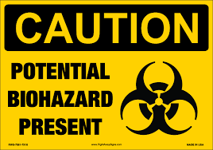
Biological
Blood Borne Pathogens (BBP)
Workplace Transmission
  Body fluids such as saliva, semen, vaginal secretions, cerebrospinal fluid, amniotic fluid, blood, and other body fluids
  Body fluids DO NOT include sweat and tears.
  Unfixed tissue or organs other than intact skin from living or dead humans

Slide 25
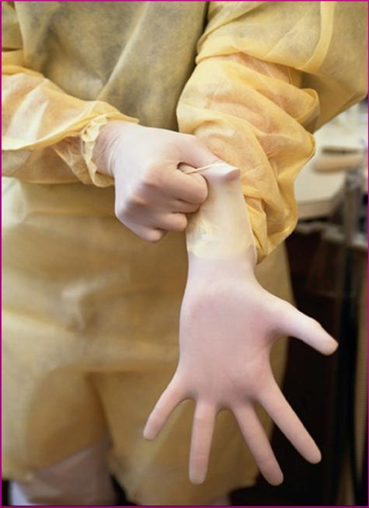
Biological
BBP Safety Rules
Follow universal precautions.
Use the required personal protective equipment.
Wash exposed areas with antibacterial soap.
Treat all human body fluids & items soiled with human body fluids as contaminated.
Report any suspected exposure to your supervisor.
Disinfect all spills of body fluid.
ACTIVITY
OSHA FACT SHEET “BLOOD BORNE PATHOGENS - PPE”

Slide 26
Biological
Diseases or illnesses can occur from biological sources:
Microorganisms (e.g., bacteria, viruses, fungi, molds)
Plant toxins
Insects and animals
  Biting and stinging arthropods (fire ants, spiders, and scorpions)
  Animals (rodents, birds, bats, and snakes)

Slide 27
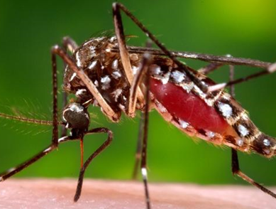
biological
Mosquitoes
Types of mosquitoes that can spread viruses increase 2 weeks to 2 months after event, especially in areas that did not flood but received more rainfall than usual.
In areas with Aedes aegypti mosquitoes and local spread of Zika, chikungunya, or dengue, increased rainfall may result in increased hatching of Aedes aegypti eggs from water-holding containers.
Notes:
Mosquitoes
Immediately following a hurricane, tornado or severe storm, flooding occurs.
Mosquito eggs laid in the soil by floodwater mosquitoes during previous floods hatch. This results in very large populations of floodwater mosquitoes. Most of these mosquitoes are considered nuisance mosquitoes.
In general, nuisance mosquitoes do not spread viruses that make people sick. The types of mosquitoes that can spread viruses may increase 2 weeks to 2 months after a hurricane, especially in areas that did not flood but received more rainfall than usual.
In areas with Aedes aegypti mosquitoes and local spread of Zika, chikungunya, or dengue, increased rainfall may result in increased hatching of Ae. aegypti eggs from water-holding containers.
People may be at more risk of getting infected with these viruses, and they should take steps to protect themselves from mosquito bites.
Because people spend more time outside cleaning up after a disaster, they are more likely to be bitten by nuisance mosquitoes. Large numbers of nuisance mosquitoes can affect recovery efforts. For this reason, local or state mosquito control experts will often take steps to control these mosquitoes.

Slide 28
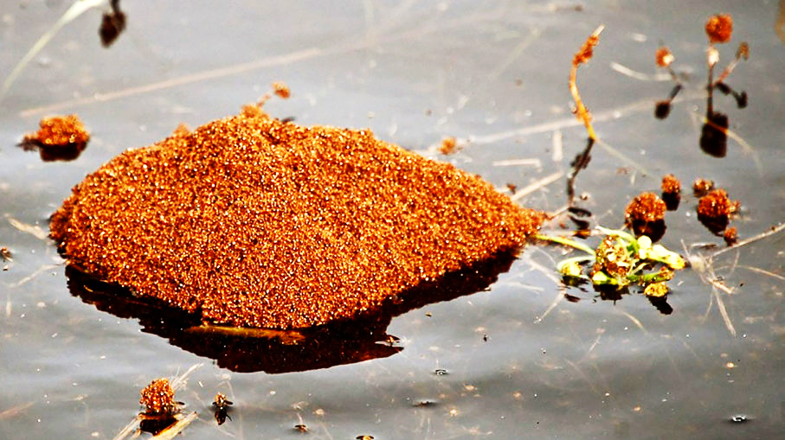
biological
FIRE ANTS
Fire ants bite and sting. They are aggressive when stinging and inject venom, which causes a burning sensation. Red bumps form at the sting, and within a day or two become white fluid-filled pustules.
Fire Ants traveling on flood water.
Notes:
Fire Ants
Fire ants bite and sting. They are aggressive when stinging and inject venom, which causes a burning sensation. Red bumps form at the sting, and within a day or two they become white fluid-filled pustules.
Protect workers from fire ants by training them about:
Their risk of exposure
How to identify fire ants and their nests
How to prevent exposure
What to do if they are bitten or stung
Worker Recommendations
Take the following steps to prevent fire ant stings and bites:
Do not disturb or stand on or near ant mounds.
Be careful when lifting items (including animal carcasses) off the ground, as they may be covered in ants.
Fire ants may also be found on trees or in water, so always look over the area before starting to work.
First Aid
Workers with a history of severe allergic reactions to insect bites or stings should consider carrying an epinephrine auto injector (EpiPen) and should wear a medical identification bracelet or necklace stating their allergy.
Workers should take the following steps if they are stung or bitten by fire ants:
Rub off ants briskly, as they will attach to the skin with their jaws.
Antihistamines may help.
Take the worker to an emergency medical facility immediately if a sting causes severe chest pain, nausea, severe sweating, loss of breath, serious swelling, or slurred speech.

Slide 29
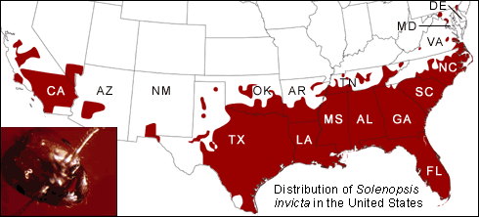
biological
Graphic courtesy of http://evolution.berkeley.edu/evolibrary/article/_0_0/fireants_02

Slide 30
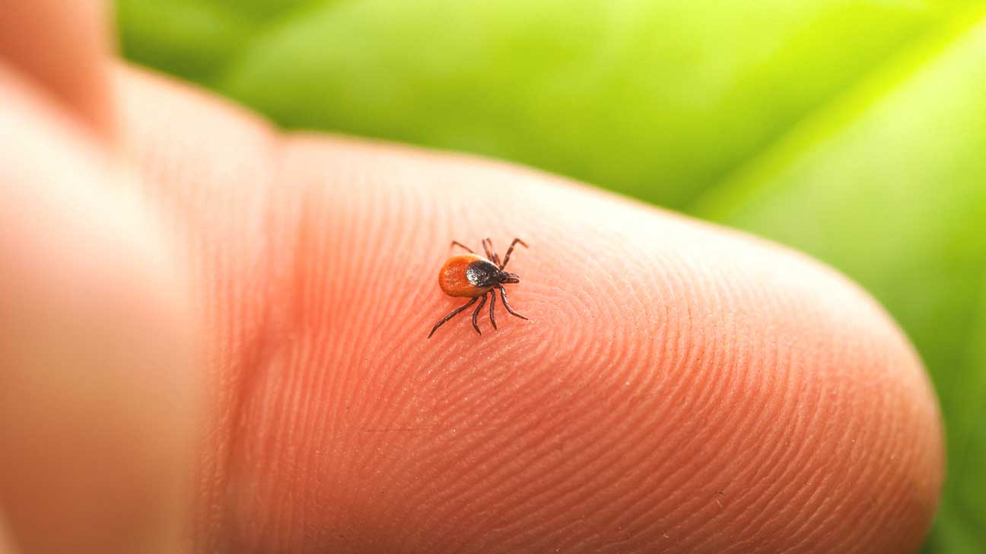
biological
Ticks
Lyme Disease - fever, headache, fatigue, and characteristic skin rash
Rocky Mountain Spotted Fever - most severe
Southern Tick-Associated Illness
Tick-borne Relapsing Fever
Notes:
Lyme Disease
Lyme disease is caused by the bacterium and is transmitted to humans by the bite of infected blacklegged ticks. fever, headache, fatigue, and a characteristic skin rash If left untreated, infection can spread to joints, the heart, and the nervous system. Most cases of Lyme disease can be treated successfully with a few weeks of antibiotics
Rocky Mountain Spotted Fever
the most severe and most frequently reported rickettsial illness in the United States. Species of bacteria that is spread to humans by ticks with sudden onset of fever headache, muscle pain and development of rash. The disease can be difficult to diagnose in the early stages, and without prompt and appropriate treatment it can be fatal.
Southern Tick-Associated Illness
A rash similar to the rash of Lyme Disease develop a red, expanding rash with central clearing. 1-3% of these ticks are infected.
Tick-borne relapsing Fever Mention this only due to the displacement of so many people to western states from the south east.

Slide 31
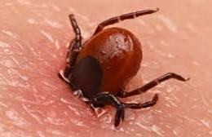
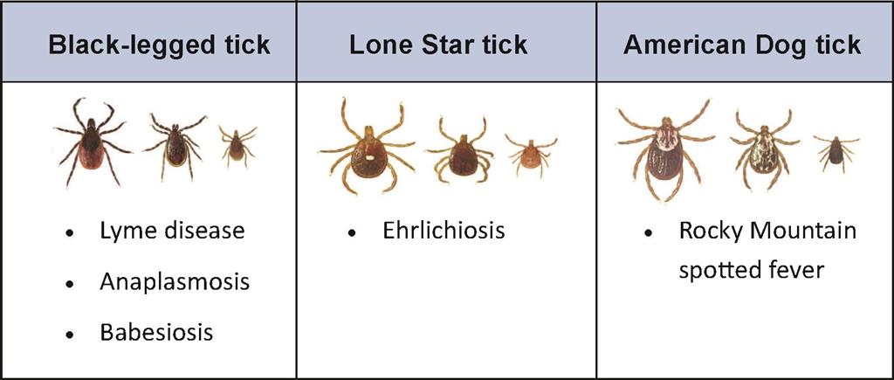
biological
Notes:
Lyme Disease
Lyme disease is caused by the bacterium and is transmitted to humans by the bite of infected blacklegged ticks. fever, headache, fatigue, and a characteristic skin rash If left untreated, infection can spread to joints, the heart, and the nervous system. Most cases of Lyme disease can be treated successfully with a few weeks of antibiotics
Rocky Mountain Spotted Fever
the most severe and most frequently reported rickettsial illness in the United States. Species of bacteria that is spread to humans by ticks with sudden onset of fever headache, muscle pain and development of rash. The disease can be difficult to diagnose in the early stages, and without prompt and appropriate treatment it can be fatal.
Southern Tick-Associated Illness
A rash similar to the rash of Lyme Disease develop a red, expanding rash with central clearing. 1-3% of these ticks are infected.
Tick-borne relapsing Fever Mention this only due to the displacement of so many people to western states from the south east.

Slide 32
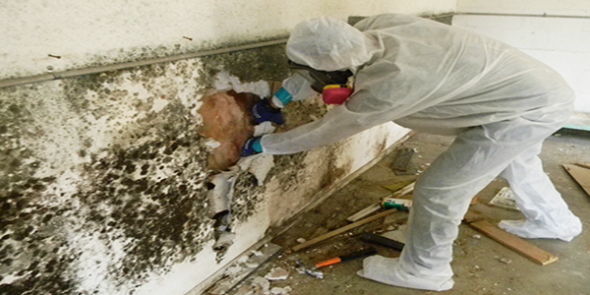
Biological
MOLD
Health issues include allergic reactions similar to common pollen or animal allergies.
Adverse health effects:
Allergy
Infection
Toxin-mediated conditions

Slide 33
Biological
MOLD
Seven signs of MOLD illness include:
Sneezing
Runny nose
Eye irritation
Coughing
Congestion
Aggravation of asthma
Skin rash
More severe health reactions, such as hypersensitivity pneumonitis, can occur in susceptible individuals.

Slide 34


Ergonomics
Site work can be physically demanding and manual material handling may be the most difficult part of the job.
Manual material handling includes all of the tasks that require you to lift, lower, push, pull, hold, or carry materials. These activities increase the risk of painful strains and sprains and more serious soft tissue injuries.
Soft tissues of the body include muscles, tendons, ligaments, discs, cartilage and nerves.
Notes:
Site work can be physically demanding and manual material handling may be the most difficult part of the job. Manual material handling includes all of the tasks that require you to lift, lower, push, pull, hold, or carry materials. These activities increase the risk of painful strains and sprains and more serious soft tissue injuries.
Soft tissues of the body include muscles, tendons, ligaments, discs, cartilage and nerves.

Slide 35
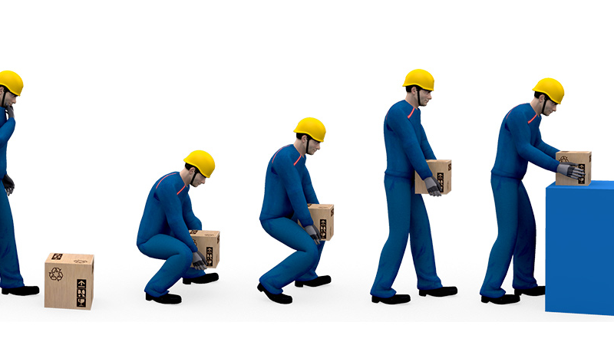
Ergonomic Hazards
heavy, frequent, or awkward lifting
repetitive tasks
awkward grips, postures
excessive force, overexertion
wrong tools for job
or using tools improperly
improperly maintained tools
hand-intensive work
Notes:
Ergonomic hazards can cause painful and disabling injuries to joints and muscles: =
heavy, frequent, or awkward lifting
repetitive tasks
awkward grips, postures
using excessive force, overexertion
using wrong tools for job or using tools improperly
using improperly maintained tools
hand-intensive work

Slide 36





Review
Identify the FOUR types on Health Hazards:
CHEMICAL
PHYSICAL
BIOLOGICAL
ERGONOMICS

Slide 37


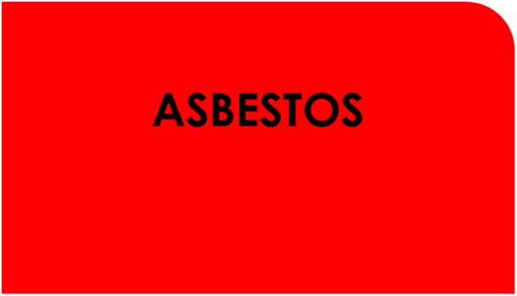



Review
Name FOUR airborne exposures identified in Health Hazards:
LEAD
ASBESTOS
SILICA
CARBON MONOXIDE (CO)

Slide 38



REVIEW - Heat stress

Slide 39


REVIEW - Noise
OSHA action level occurs at how many decibels?
65dB
85dB
92dB
126dB

Slide 40
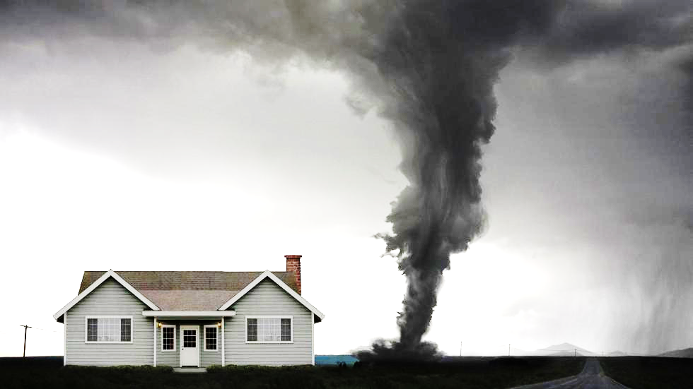
Dashboard
SAFETY HAZARDS

